Slide 1
INTRODUCTION TO
ALGORITHMS
FOURTH EDITION

Slide 2
LECTURE NOTES FOR CHAPTER 19
Data Structures for Disjoint Sets

Slide 3
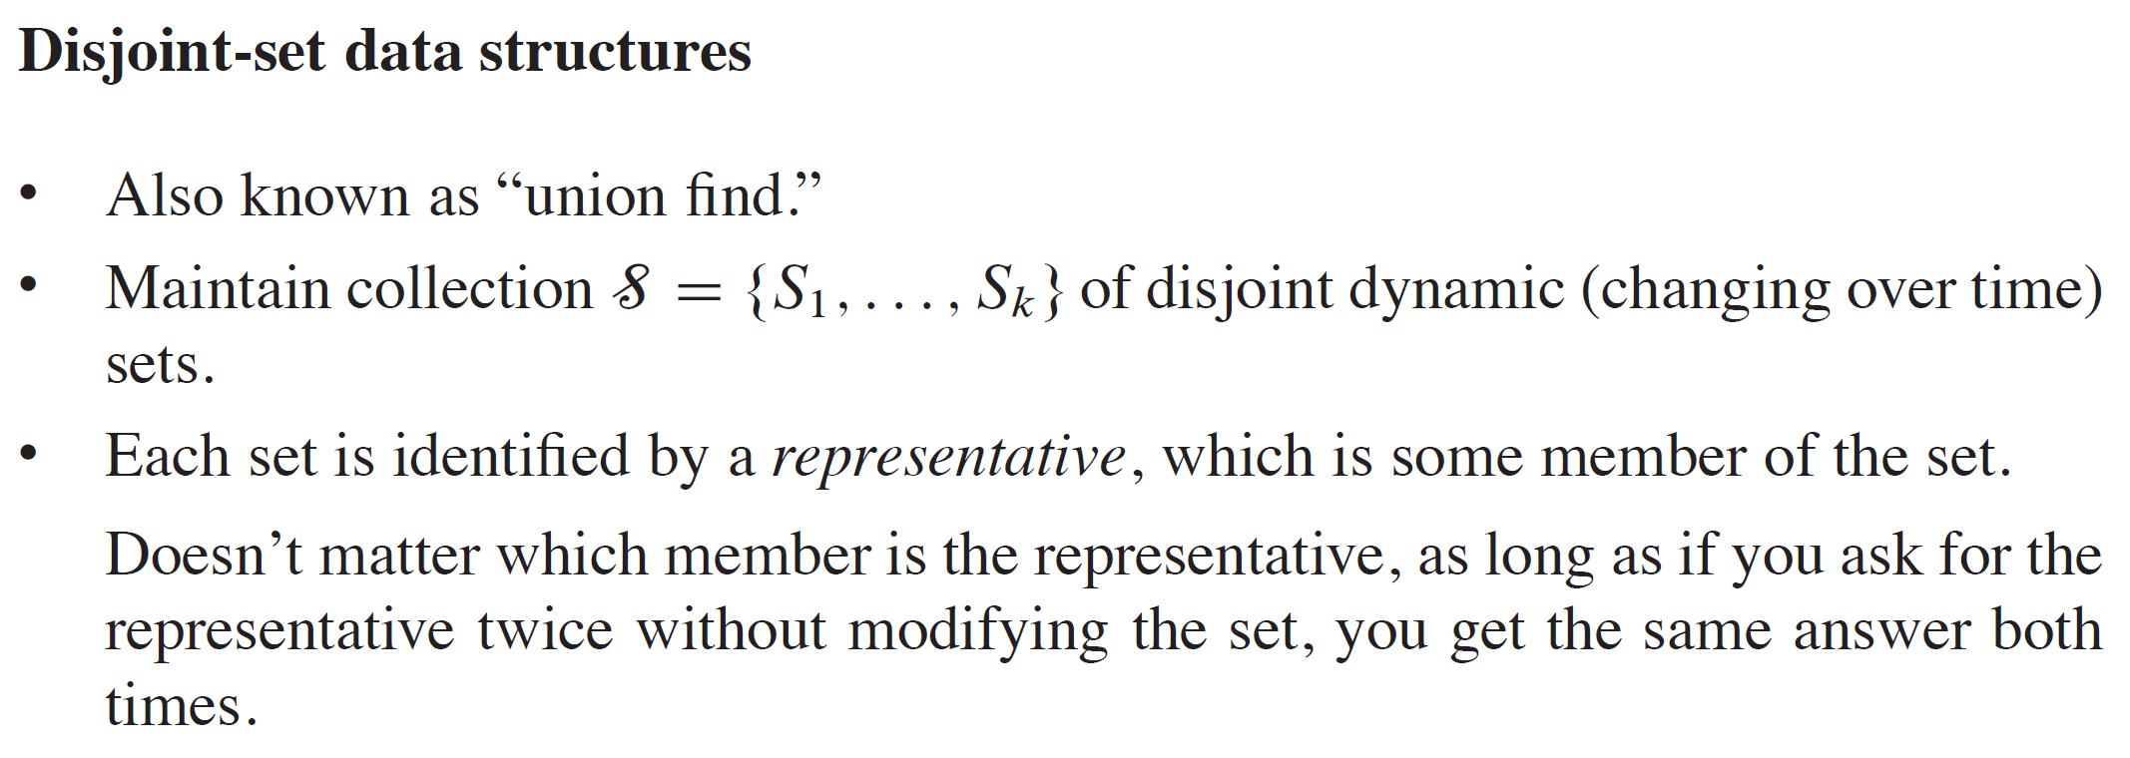
CHAPTER 19 OVERVIEW

Slide 4
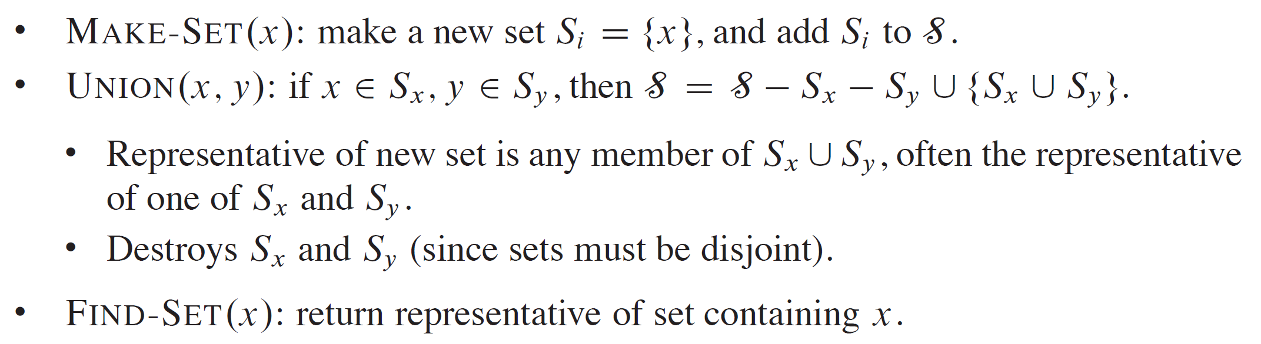
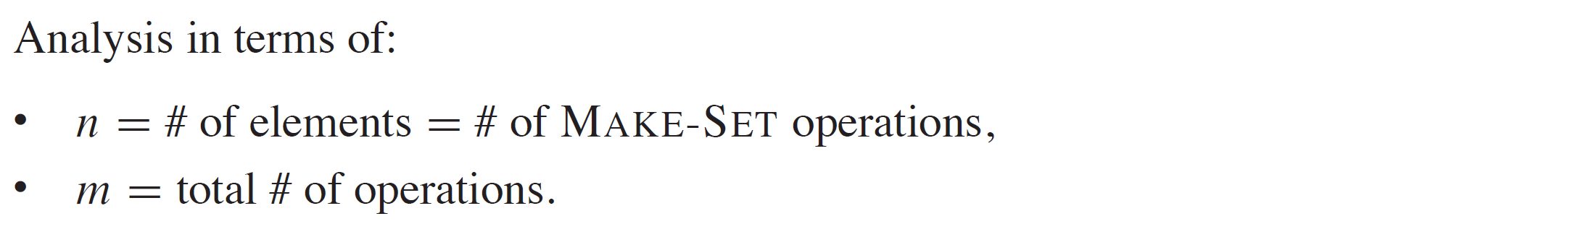
OPERATIONS

Slide 5
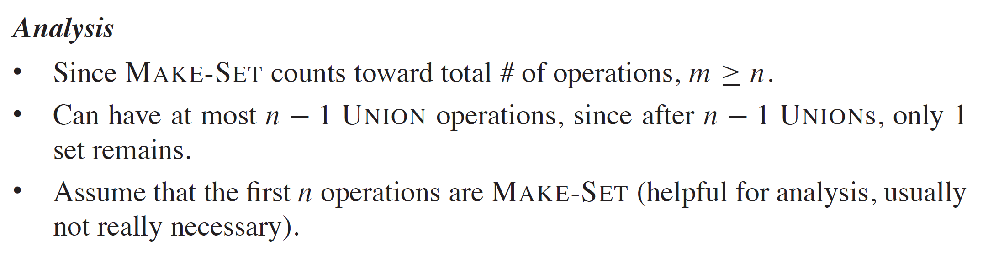
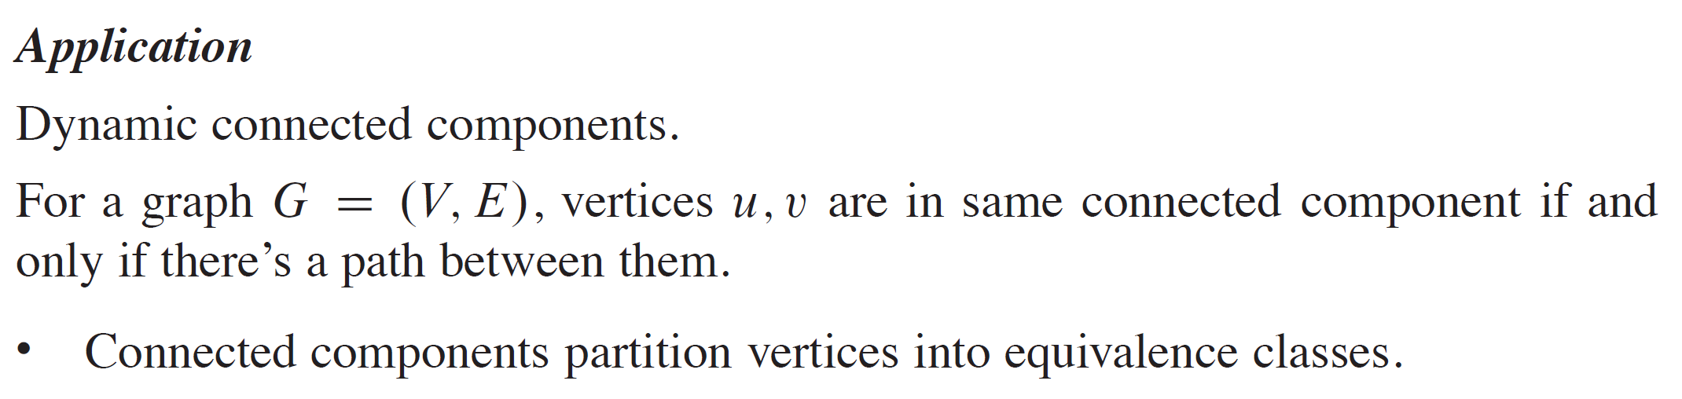
OPERATIONS (continued)

Slide 6
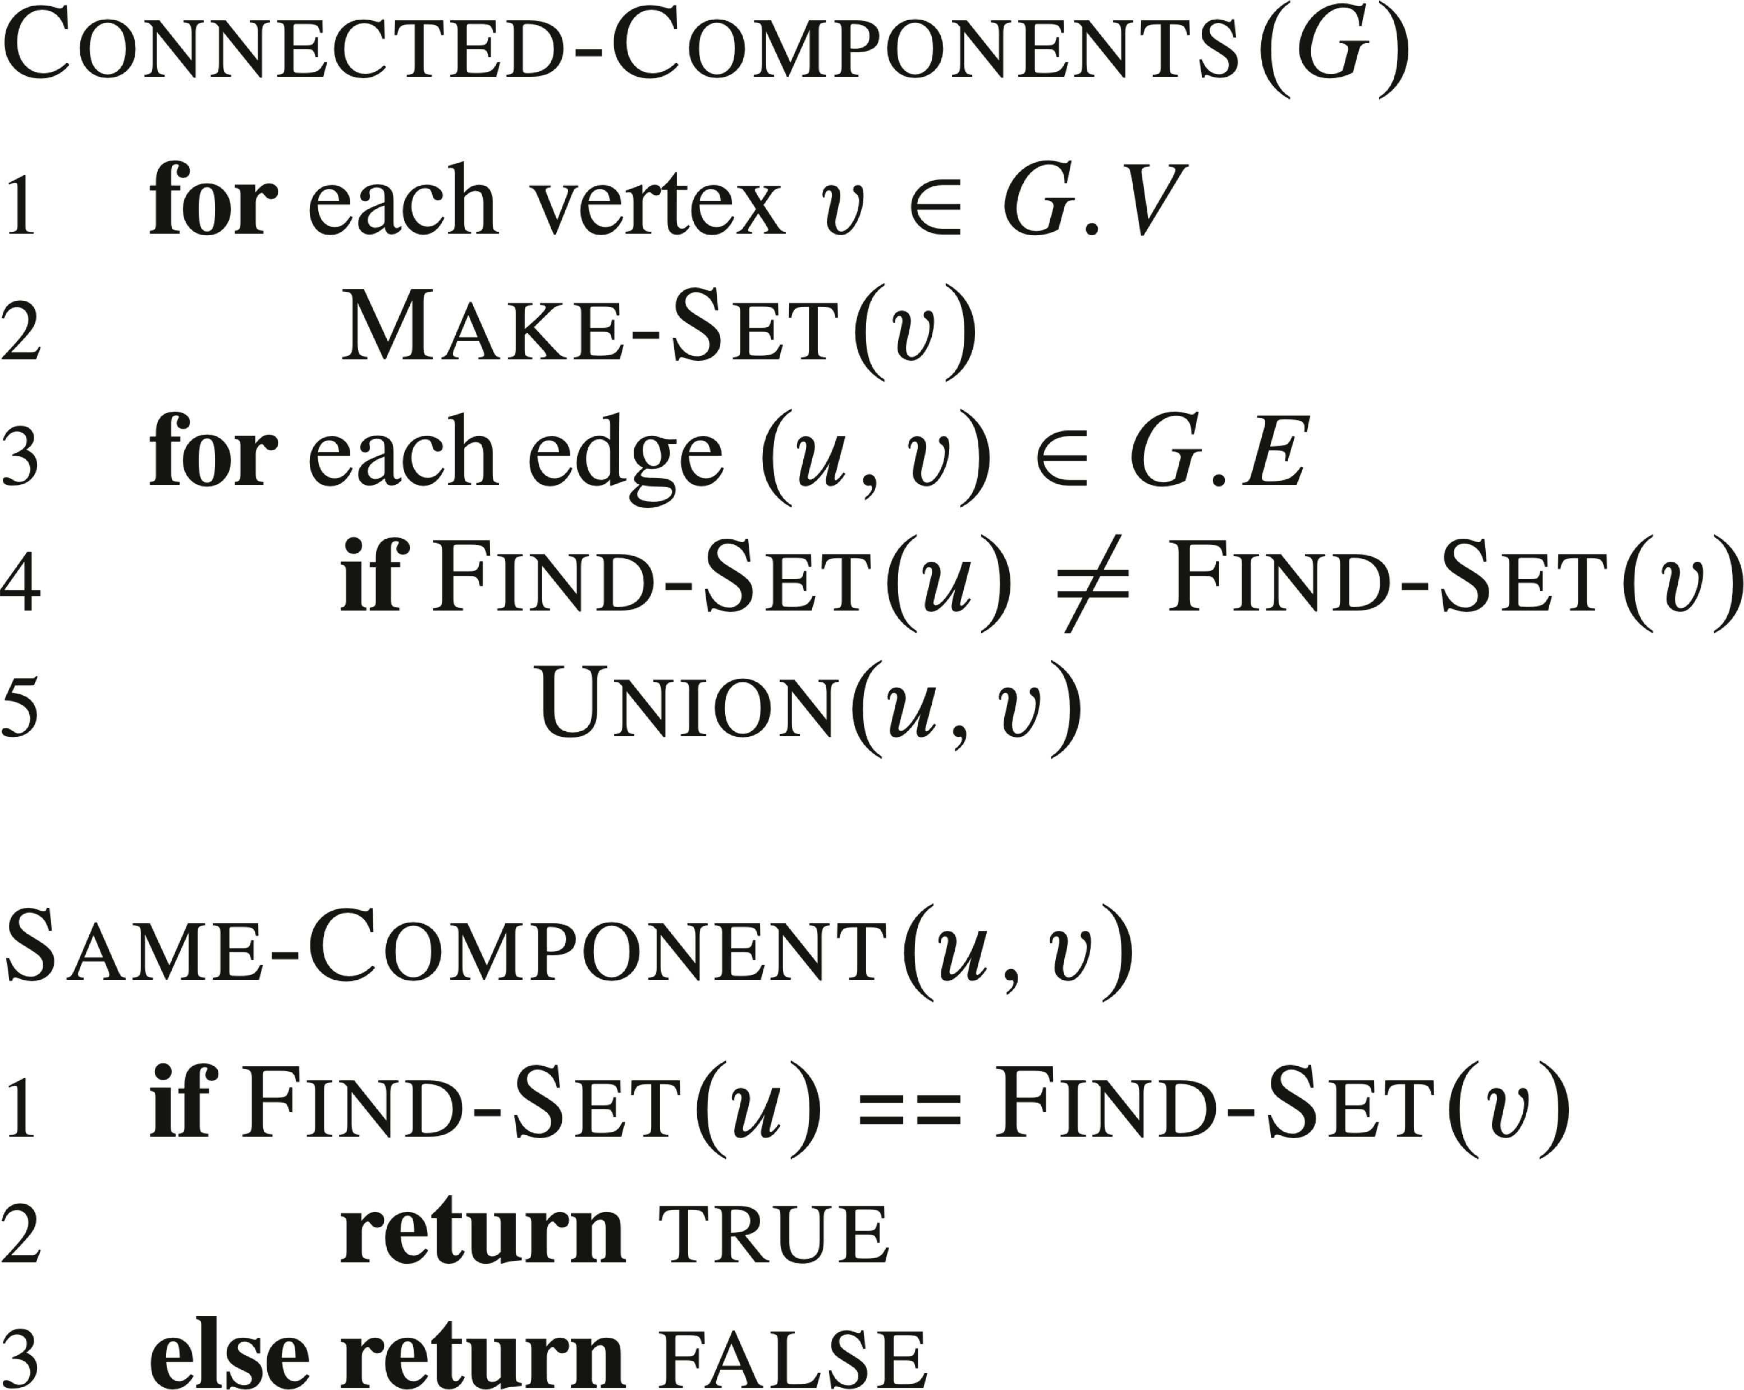
OPERATIONS (continued)
Note: If actually implementing connected components,
each vertex needs a handle to its object in the disjoint-set data structure,
each object in the disjoint-set data structure needs a handle to its vertex.

Slide 7
LINKED LIST REPRESENTATION
Each set is a singly linked list, represented by an object with attributes
head: the first element in the list, assumed to be the set’s representative, and
tail: the last element in the list.
Objects may appear within the list in any order.
Each object in the list has attributes for
the set member,
pointer to the set object, and
next.

Slide 8
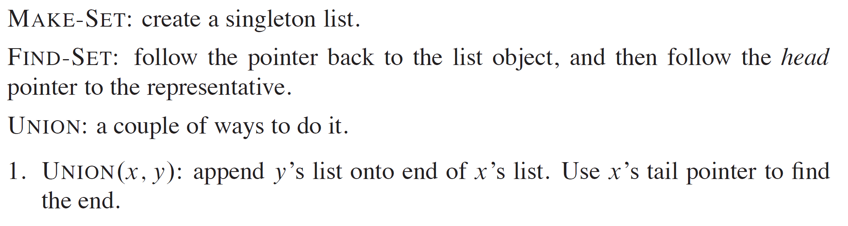
LINKED LIST REPRESENTATION (continued)

Slide 9
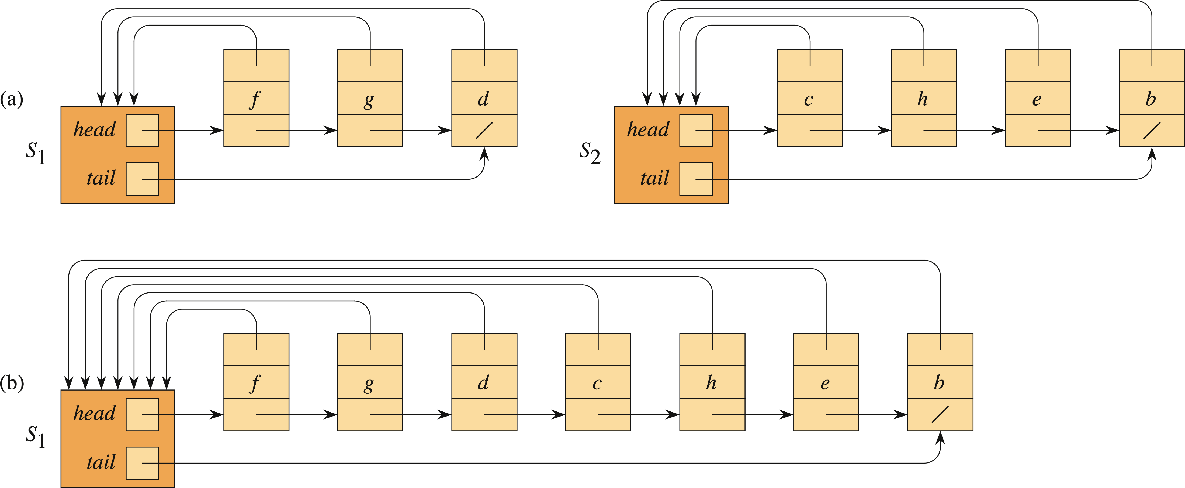
LINKED LIST REPRESENTATION (continued)

Slide 10
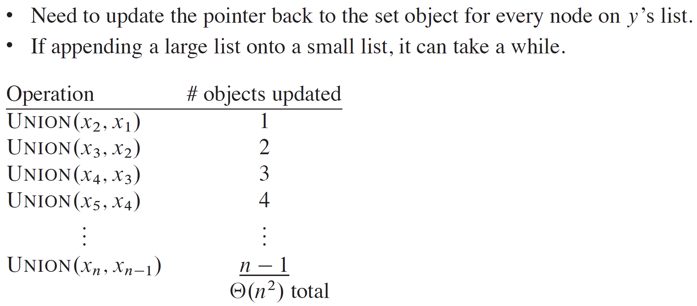
LINKED LIST REPRESENTATION (continued)

Slide 11
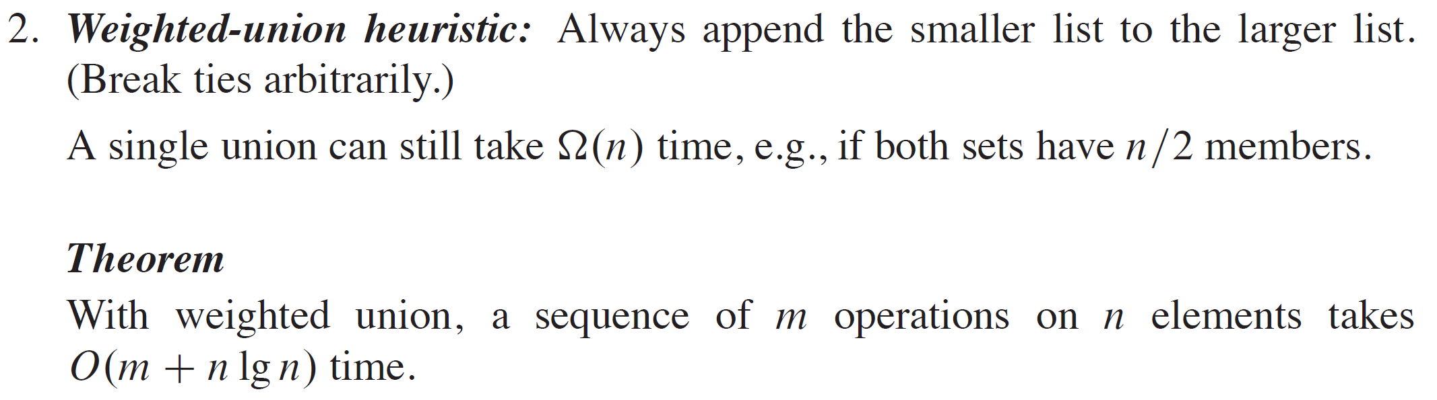
LINKED LIST REPRESENTATION (continued)

Slide 12
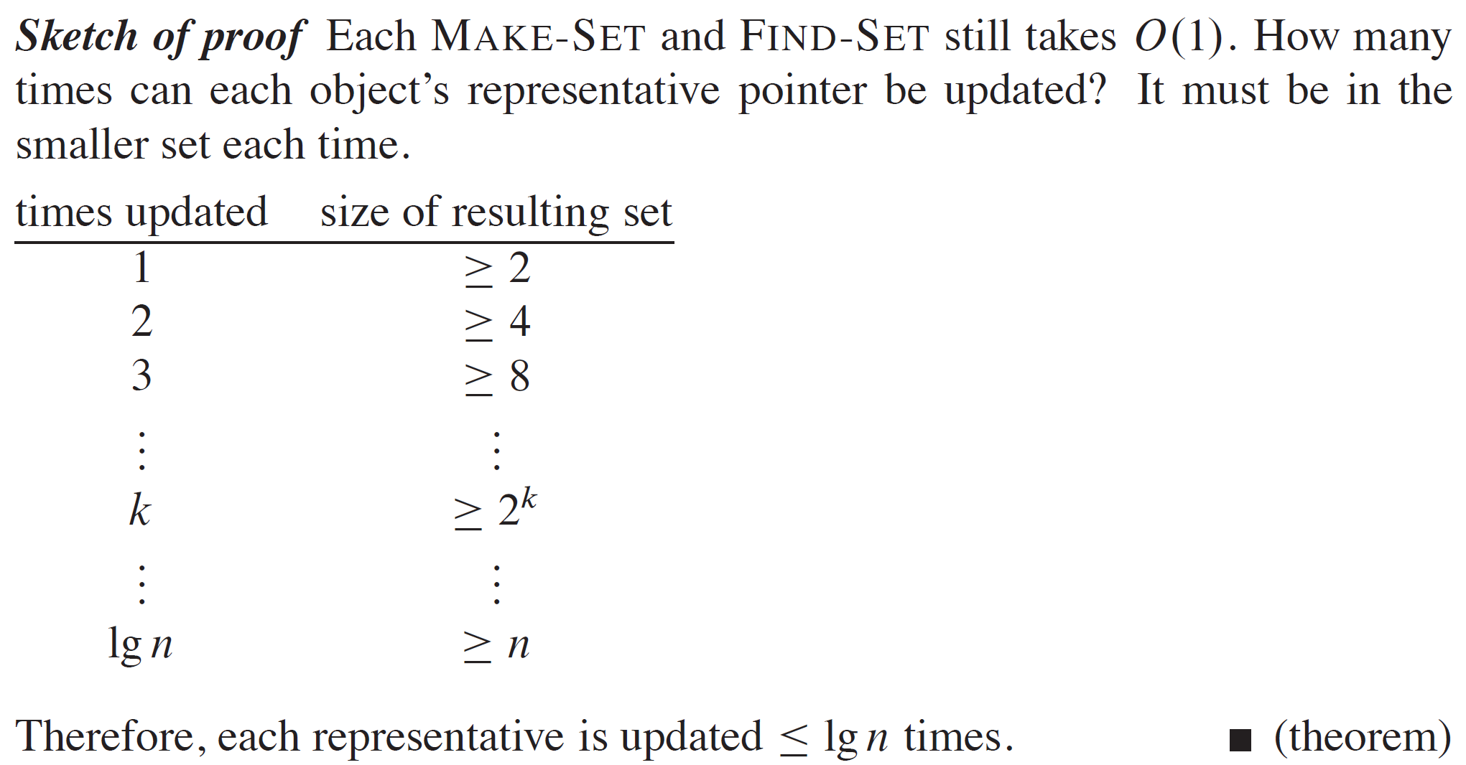
LINKED LIST REPRESENTATION (continued)

Slide 13
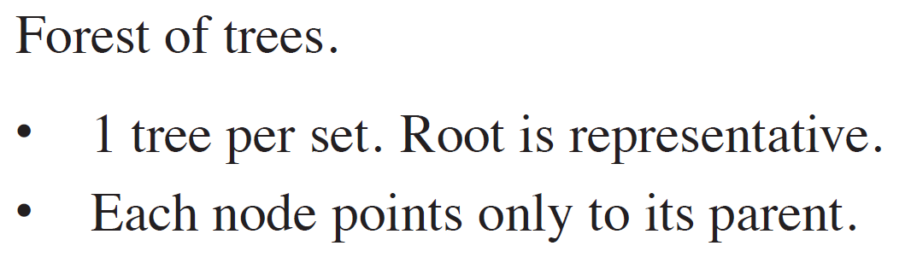
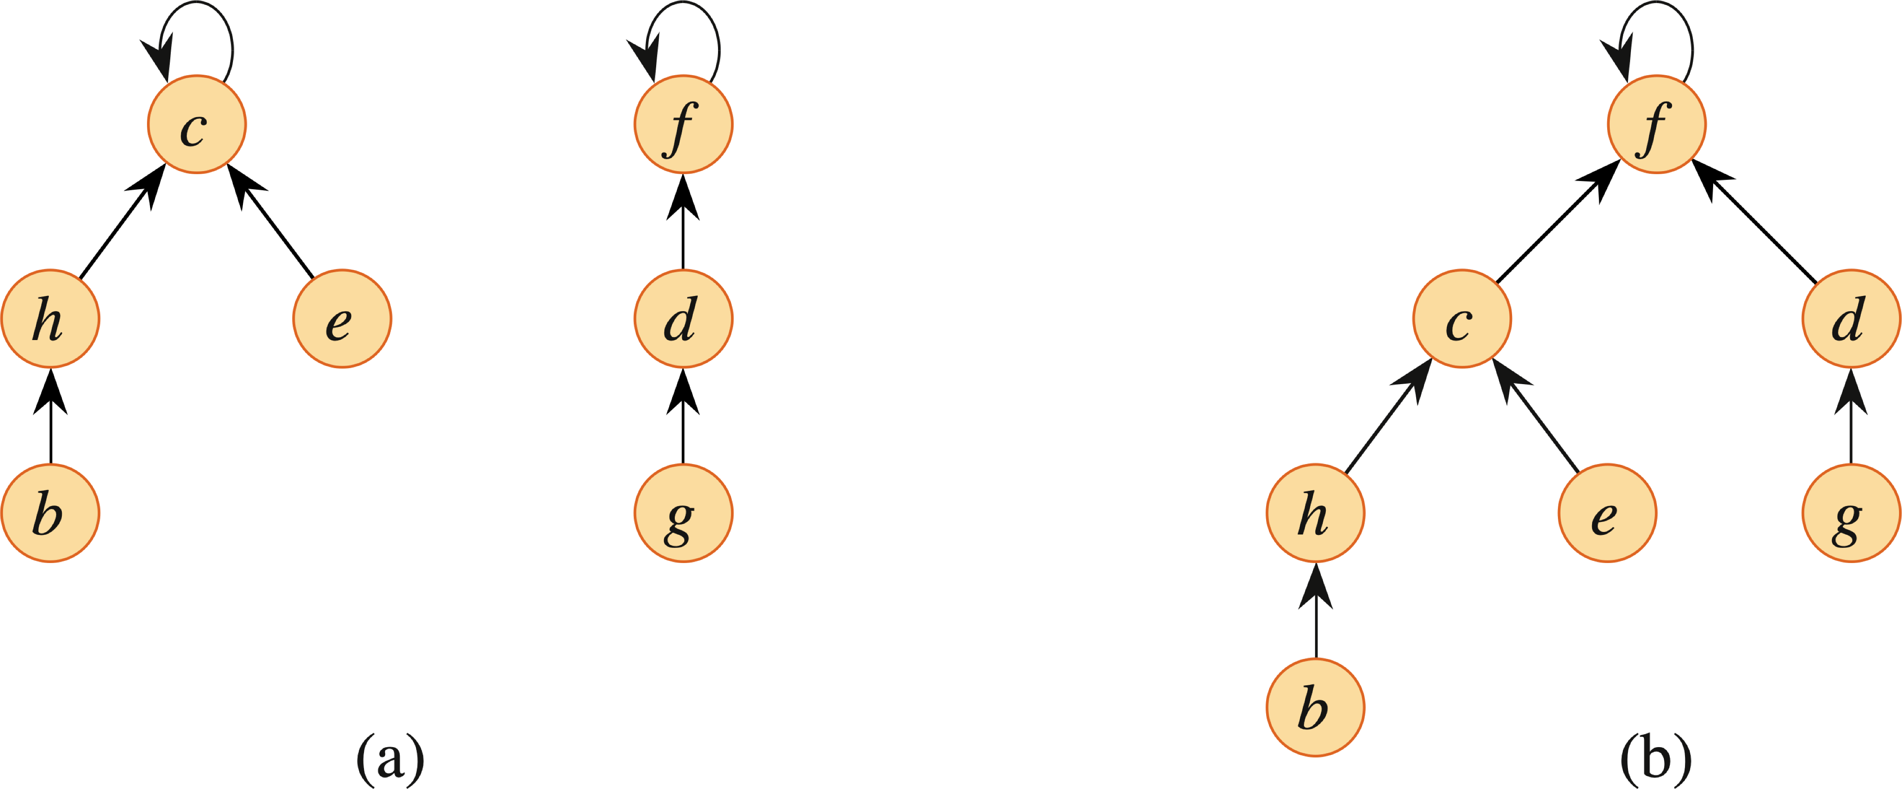
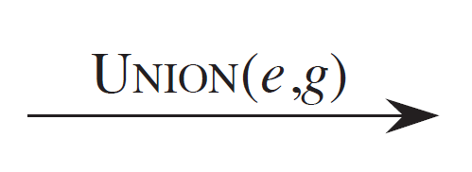
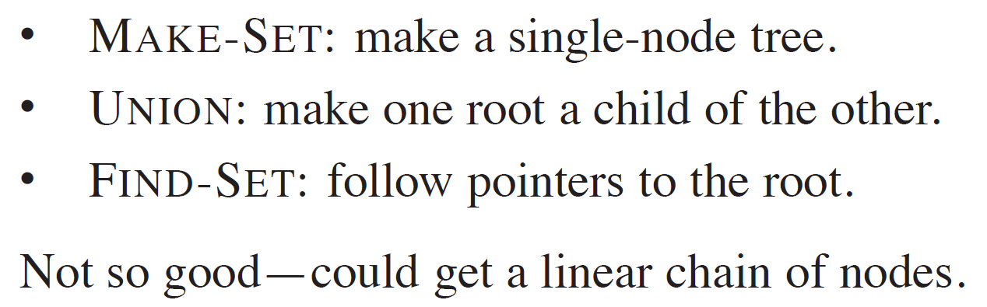
DISJOINT-SET FOREST

Slide 14
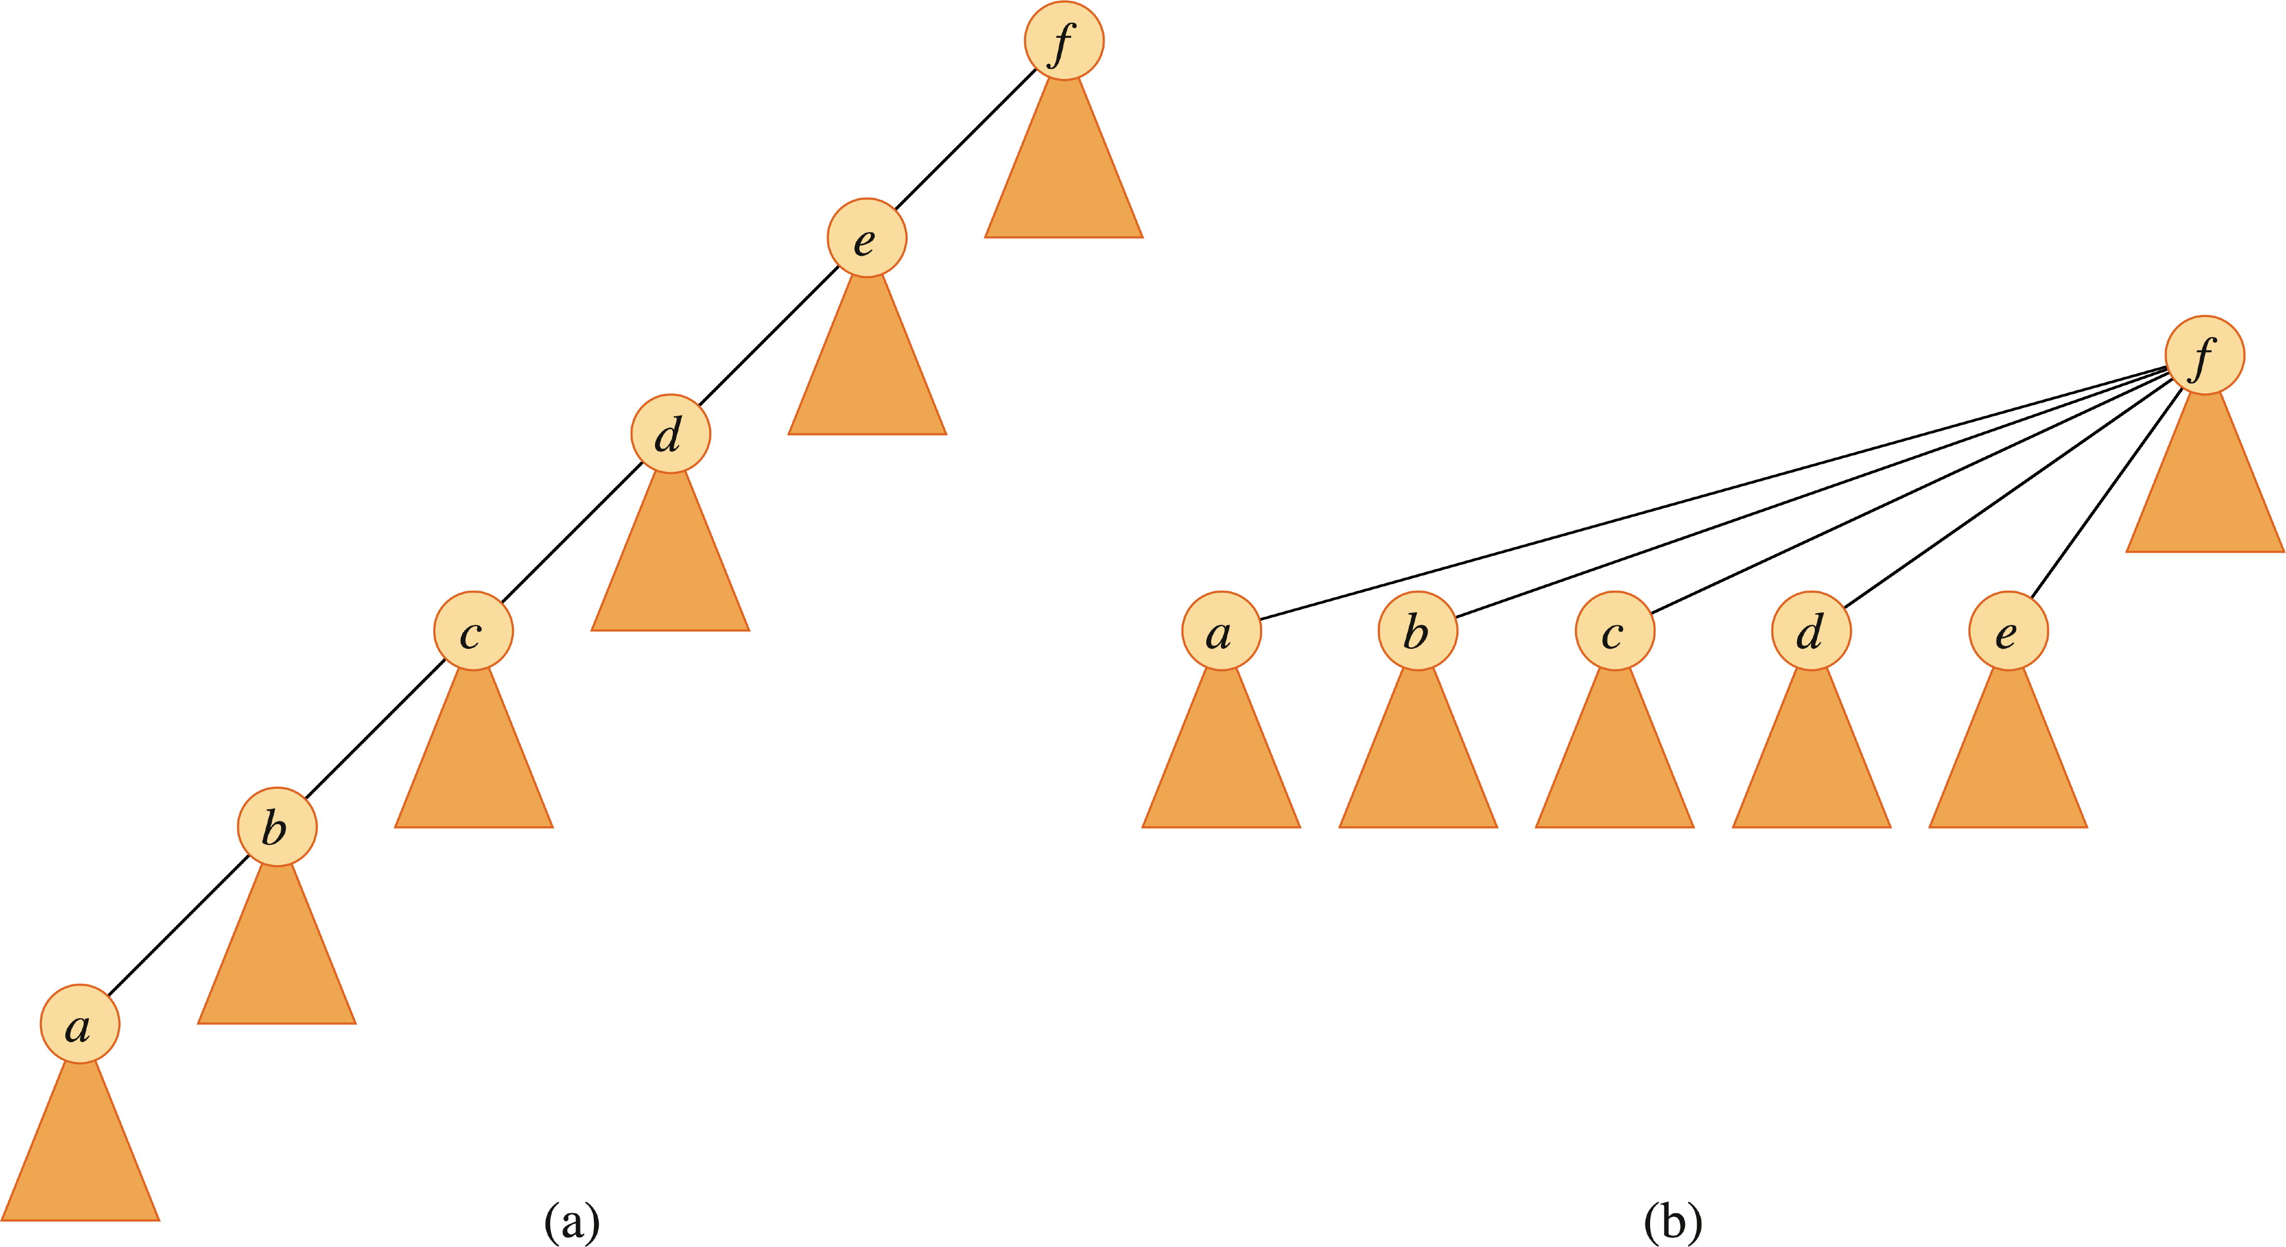

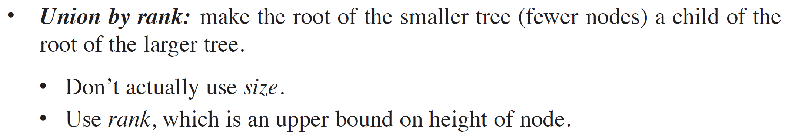
GREAT HEURISTICS

Slide 15
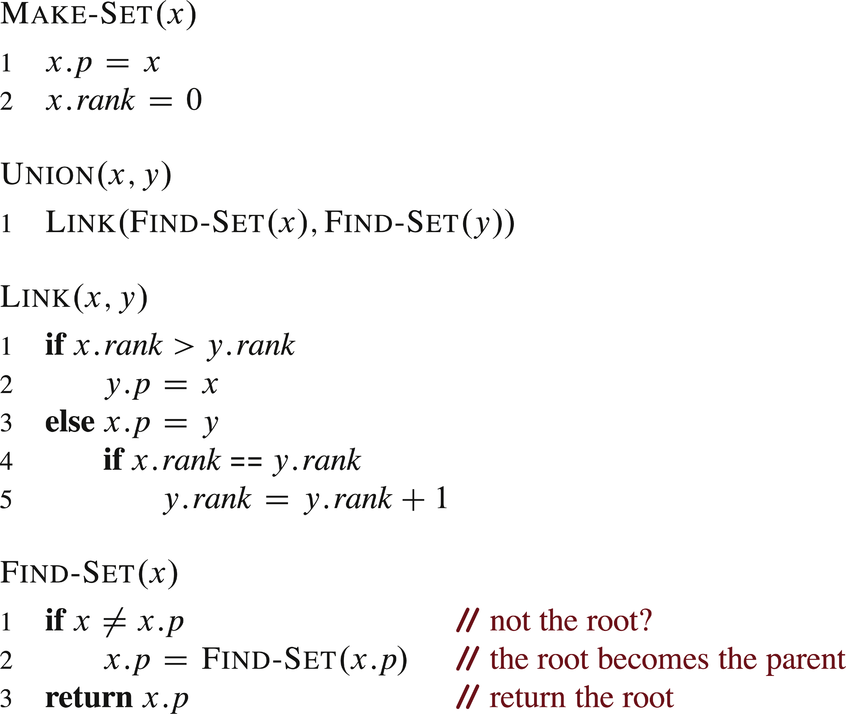
GREAT HEURISTICS (continued)

Slide 16
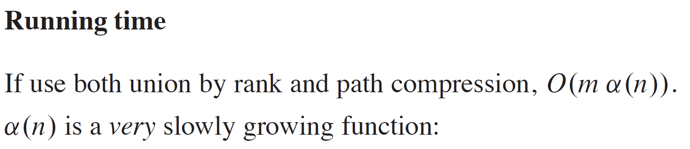
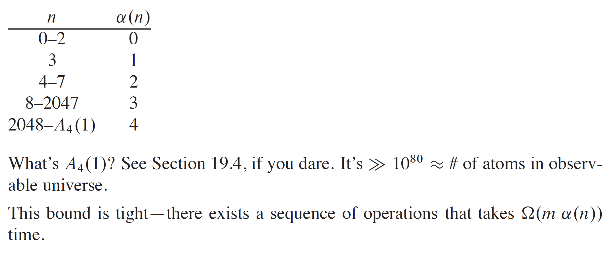
GREAT HEURISTICS (continued)

